Slide 1
Recurrent Inductive Bias
Can we Transfer it?
The contents of this presentation is from our paper on ”Transferring Inductive Biases through Knowledge Distillation” which is currently under submission!

Slide 2
Inductive Bias
All models generalize
The set of assumptions that determine the generalization behavior of a learning algorithm!
Any bias that is not coming from data
Architectural choices,
Optimization algorithms,
Curriculum strategies
Objective, Regularizations, etc.
Why do we care about inductive biases?
From the cognitive modelling perspective
They are essential when data or computation is limited
From the blog post for the paper ``Does syntax need to grow on trees? Sources of hierarchical inductive bias in sequence-to-sequence networks’’

Slide 3
Transferring Inductive Biases
Realizability vs. Learnability
We assume that the solutions we are interested in are reaizable for all the models that we work with.
It is not equally easy to reach the solution with different models
Some models have a more suitable inductive bias!
Model Capacity is not the problem!
If compute is not an issue we can apply a brut force method to find the optimum solution!

Slide 4
Inductive Bias

Slide 5
Inductive Bias

Slide 6
Recurrent Inductive Bias
The inductive bias of RNNs is often referred to as the recurrent inductive bias.
It is shown that the recurrent inductive biases of RNNs helps them learn the hierarchical (linguistic) structures in the inputs.

Slide 7
Recurrent Inductive Bias
A task to assess the ability of models to capture hierarchical structures in language:
Subject-verb agreement task of (Linzen et al. 2016)

Slide 8
On the Importance of Recurrent Inductive Bias in Capturing Hierarchical Structure in Language

Slide 9
What is Recurrent Inductive Bias?
The sequential processing of the input: There is an inherent notion of order in the architecture that forces the model to access next tokens in the input one by one.
No direct access to the past tokens: The model has to compress all the information from past tokens in a hidden state/memory, which is accessible when processing the next token.
Recursion: The model recursively applies the same function on the varying input at every time step.

Slide 10
Examining the Sources of Recurrent Inductive Bias

Slide 11
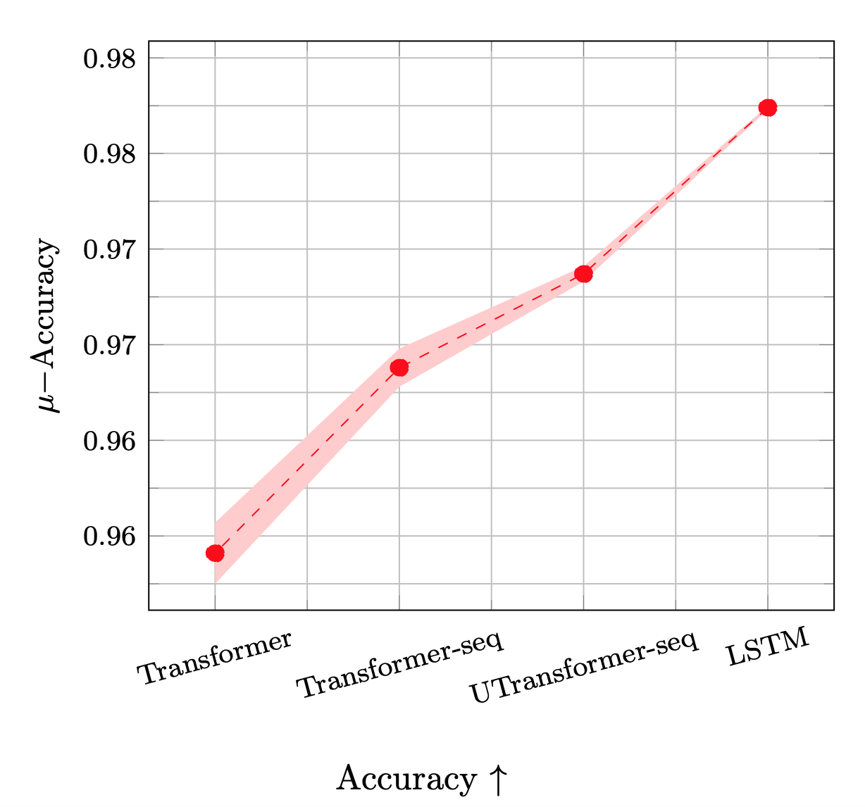
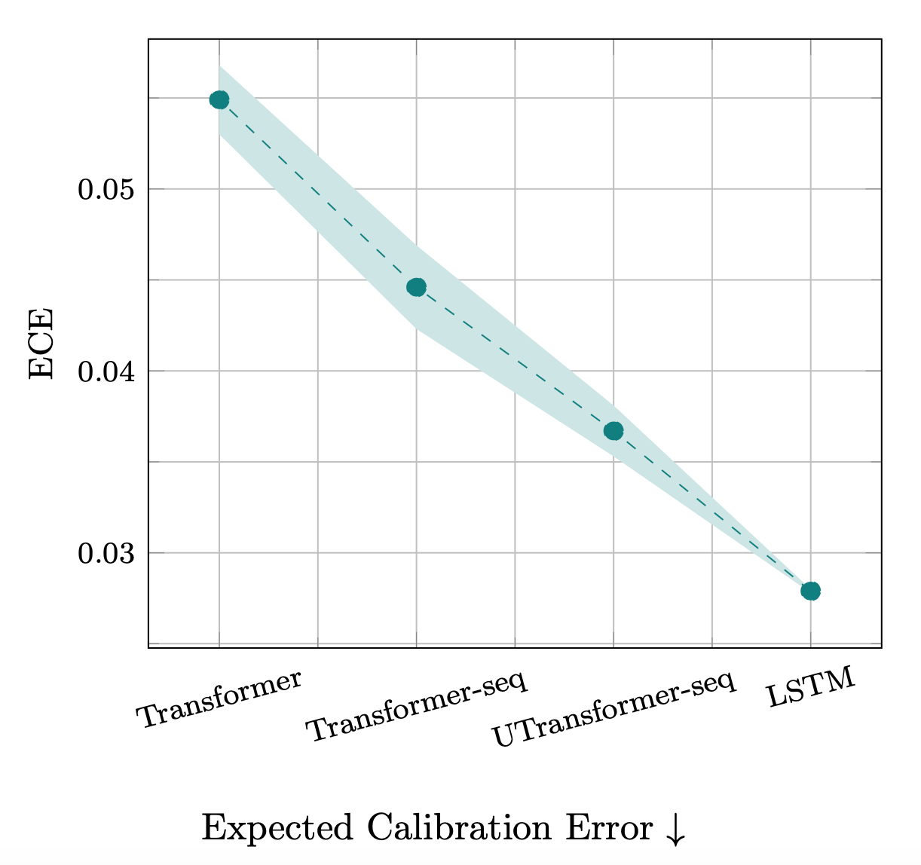
Examining the Sources of Recurrent Inductive Bias

Slide 12
Distilling Inductive Biases

Slide 13
Distilling Inductive Biases

Slide 14
Distilling the Recurrent Inductive Bias

Slide 15
Distilling the Recurrent Inductive Bias

Slide 16
Effect of Distillation on the Internal Representations
Similarity of the models after convergence when they are trained independently or through distillation.

Slide 17
To conclude…
In our previous research, we found some evidence that the representations obtained from RNNs is more similar to human brain activity patterns compared to Transformers!
We speculated that this is because of the recurrent inductive bias!
Here, we show that the effect of inductive bias transfers through distillation!
Now, to confirm the cognitively relevancy of the inductive bias of RNN in the previous study, we can see if…

